Slide 1
Logistic Regression Part II

Slide 2
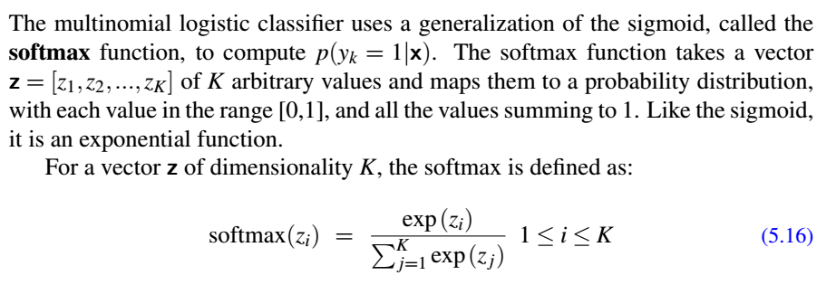
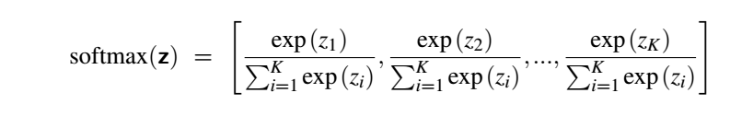
We have k classes. In the training set for a particular example X, it belongs to only one class Yc.
So yc = 1 and Yj = 0 for all j not equal to c. Y looks like [0,0,0,..1, 0,0,0]. This is called one hot vector.

Slide 3


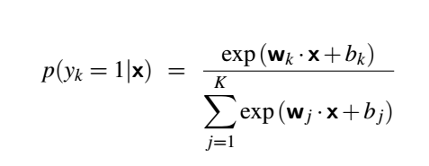
After applying softmax function the probabilities of the classes are
Each row k of W corresponds to the vector of weights Wk. W thus has shape [K × f ], for K the number of output classes and f the number of input features. The bias vector b has one value for each of the K output classes. If we represent the weights in this way, we can compute yˆ, the vector of output probabilities for each of the K classes, by a single matrix multiplication
yˆ = softmax (Wx+b)

Slide 4
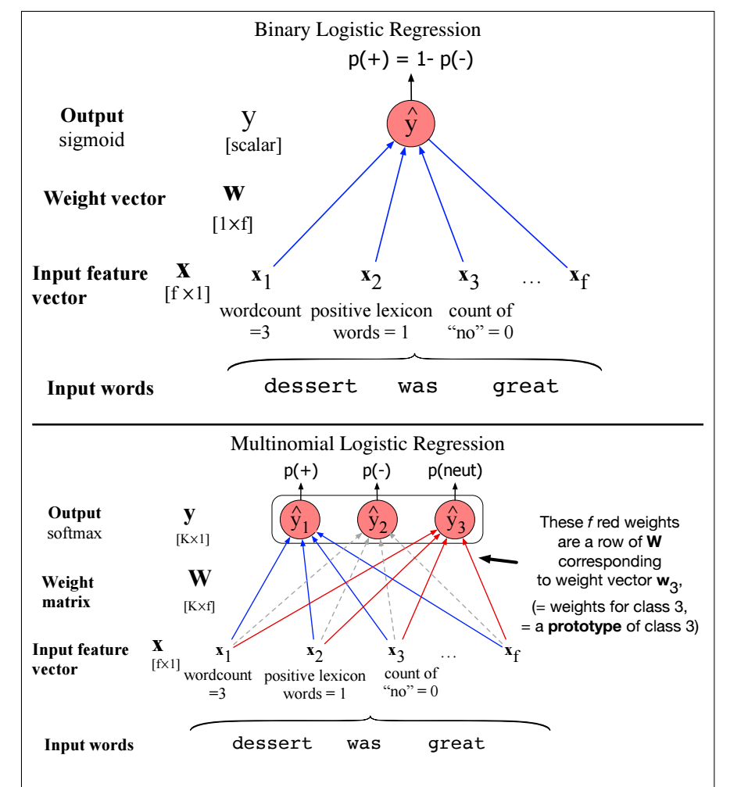

Slide 5
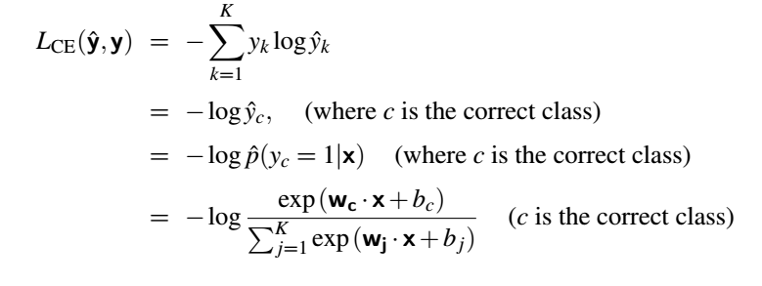
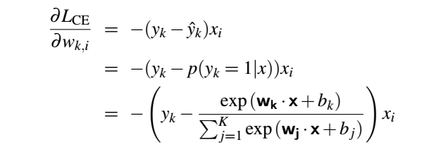

Slide 6
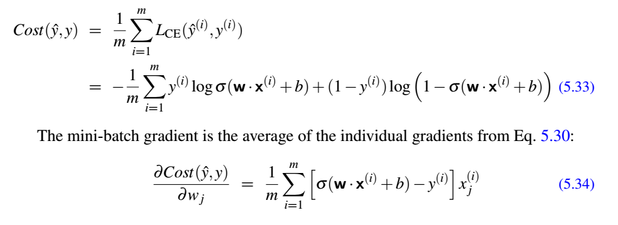
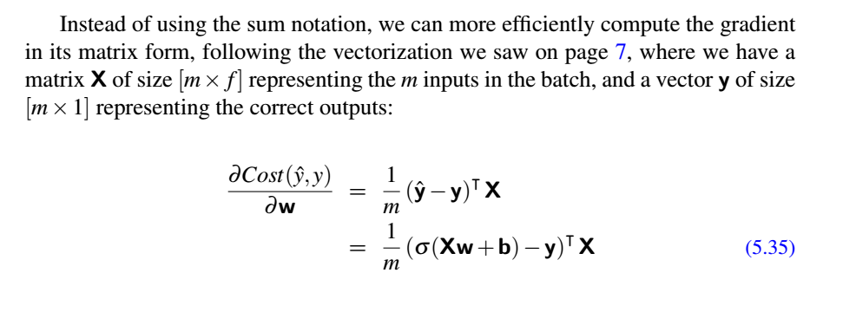
Stochastic vs Minibatch processing

